Slide 1
Resume Parser and Career Path Recommender
Team Members:
S Sai Girish (16CO244)
Vasudev B M (171CO150)
Chethan (171CO113)

Slide 2
Problem statement
Objectives
To build a resume parser which acts as an input to a Career Path Recommender and Upskilling.
We have to provide the future career/post along with salary forecasting and suitable skills which are recommended to be known for that career path.
Obtain resumes belonging to different supported industries from online sources
Parse each resume for relevant information, such as contact details, academic background and skill set.
Scrape the Job Profile data from Payscale website.
Using extracted skills, obtain the current job profile of the user
Recommend the future career path and required skills each of the job profiles in the career path.
Forecast the expected salary after a period of five to nine years for each suggested job profile

Slide 3
Literature Survey

Slide 4
Resume Parser with Natural Language Processing
User uploads the resume to the web platform.
Parse information from the resume using natural language processing, find the keywords, cluster them onto sectors based on their keywords and lastly show the most relevant resume to the employer based on keyword matching.
Were able to scrape the keywords from different social networking sites including Stack Overflow, LinkedIn etc, and similarity between them with which genre of the resume could be found out.
Link:https://www.researchgate.net/publication/313851778_Resume_Parser_with_Natural_Language_Processing

Slide 5
Combination of Neural Networks and Conditional Random Fields for Efficient Resume Parsing.
The current job recruitment horizon demands better approaches for efficient resume parsing technologies and methods.
The paper proposes a system for resume parsing using deep learning models such as the convolutional neural network (CNN), Bi-LSTM (Bidirectional Long ShortTerm Memory) and Conditional Random Field (CRF).
CNN model is used for segmentation and compared with a BiLSTM model.
A CRF based model is chosen for information extraction and compared with a Bi-LSTM-CNN model.
The output is of JSON format and contains 23 fields.
Link : https://ieeexplore.ieee.org/document/8530883.

Slide 6
Resume Parser : Semi-structured Chinese document analysis
According to the semi-structured characteristics of the resume, we can apply the information retrieval based on regular expression and text automatic classification to extract information.
It can read, analysis, retrieval and store the information automatically.
Experiment shows that results, accuracy, and efficiency of the system satisfies the general practical requirements.
The research on the processing of the semi-structured document, it will not only be as a directive of the further research on the resume analysis, but also be as the reference to other form of the semi-structured document.
The accuracy of the results can be improved by using fuzzy matching algorithm.
Link : https://ieeexplore.ieee.org/document/5170487.

Slide 7
Career Recommendation System using Content based Filtering
Existing job recommendation systems only take into consideration the domain in which the user is interested while ignoring their profile and skillset, which can help recommend jobs which are tailor made for the user.
This paper examines career recommendation system and highlights the drawbacks of these systems, such as cold start, scalability and sparsely.
Proposed implementations of career recommender systems introduce features of security, reliability and transparency in the process of career recommendation using ML.
It takes as input the proficiency of the skill of the user in a particular subject.
Users can extend their portfolio and resume to have the option to propel their vocations further.
The student’s profile can be handled in a more secure way by providing data encryption.
Link : https://ieeexplore.ieee.org/abstract/document/9137992

Slide 8
CaPaR : A Career Path Recommendation Framework
At present, there are many job posting websites providing a huge amount of information and students need to spend hours to find jobs that match their interests.
Existing job recommendation systems only consider the user’s field of interest, but do not take into consideration the user’s profile and skills, which can generate more relevant career recommendations for users.
Using text mining and collaborative filtering techniques the system first scans the user’s profile and resume, identifies the key skills of the candidate and generates personalized job recommendations.
The system not only allows its users to explore large amounts of information, but also expand their portfolio and resume to be able to advance their careers further.
Link : https://ieeexplore.ieee.org/document/7944917

Slide 9
Job Recommendation through Progression of Job Selection
This paper introduces a novel machine learning model which uses the candidates’ job preference over time to incorporate the dynamics associated with highly volatile job market.
In addition to this, the approach also comprises several other smaller recommendations that contribute to problems such as:
a) generating serendipitous recommendations.
b) solving the cold-start problem for new jobs and new candidates.
Also shown the use of latent competency groups helps in capturing the hidden skill domains for the candidates and the jobs.
The best results have been achieved through Bidirectional Long Short Term Memory Networks (Bi-LSTM) with Attention for recommending jobs through machine learning that forms a major part of our recommendation.
Link : https://ieeexplore.ieee.org/abstract/document/9073723

Slide 10
Implementation of salary prediction system using data mining technique.
A data mining technique is applied to generate a model to predict a salary for individual students who have similar attributes to the training data.
The system is designed to support individual based salary prediction by comparing profiles of current student and graduated students.
Salary prediction experiments compared Decision trees, Naive Bayes, K-Nearest neighbor, Support vector machines, and Neural networks.
Results showed that K-Nearest neighbor provided the best efficiency to be used as a model for salary prediction.
Results showed that the system was effective in boosting students’ motivation for studying and also gave them a positive future viewpoint.
The prediction results were simple to understand without requiring any background knowledge.
Link : https://ieeexplore.ieee.org/document/7951419

Slide 11
Design of a novel Prediction Engine for predicting suitable salary for a job.
Prediction engine is a tool which can forecast a future outcome using a set of past observation.
Focused on the problem of predicting salary for job advertisements in which salary are not mentioned and also tried to help fresher to predict possible salary for different companies in different locations.
Machine Learning techniques are used to automate and formulate a proposed model for salary prediction.
The proposed approach a raw dataset is fit into decision models like decision tree and ensembles model.
The results obtained are encouraging and with high precisions.
Link : https://ieeexplore.ieee.org/abstract/document/8718711

Slide 12
Salary Predictor System for Thailand Labour Workforce using Deep Learning
Used Deep Learning techniques to construct a model which predicts the monthly salary of job seekers in Thailand solving a regression problem which is a numerical outcome is effective.
Algorithm has an automatic feature extraction that means the algorithm automatically snap the relevant features required for the solution of the problem.
Deep Learning techniques are used to automate and formulate a proposed model for salary prediction.
Compared the performance with related algorithms such as Random Forest and Gradient Boost Trees. After comparing feature selection methods were applied to Deep Learning.
Link : https://ieeexplore.ieee.org/document/8587998

Slide 13
Dataset

Slide 14
For the Resume Parser, we have used resumes, both in .pdf and .doc formats
Resumes are taken from the following link:
https://drive.google.com/file/d/17M9oDPip5JFFFNJhDCBQKy8BMqoyxajU/view
A linkedIn skills dataset is used to compare and match skills from the resumes. It consists of 36495 different skills
For the career path recommender and salary forecasting, we have taken 100 profiles from six industries for a total of 600 job profiles.
The job profiles data is divided into 500 profiles for training and 100 profiles for testing
All the job profiles data is obtained by scraping the payscale website.

Slide 15
Methodology
Career Path Recommender
Salary Forecasting
Resume Parser

Slide 16
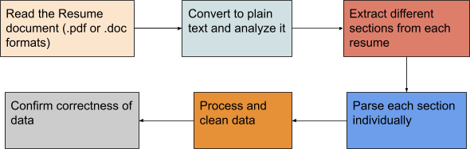

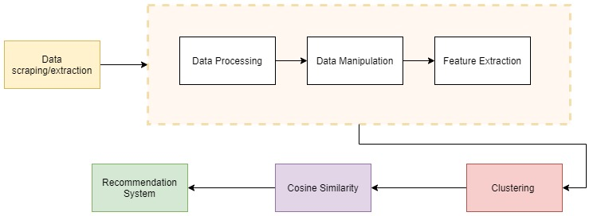
Overall Architecture
RESUME PARSER
3. SALARY FORECAST
2. CAREER PATH RECOMMENDER

Slide 17
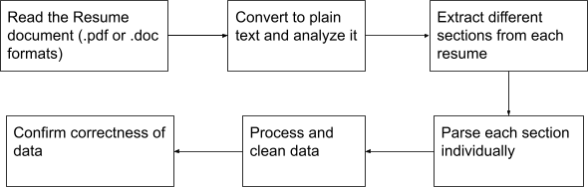
Resume Parser
Read the resume and convert it to plain text, i.e. extract text from .pdf and .doc, .docx file formats.
Extracted Info - Name, Contact Details, Education Qualifications, Skillset
Tools used: PdfMiner, Doc2Text

Slide 18
Career Path Recommender

Slide 19
Data Scraping/Extraction
Scraped the PayScale website to obtain individual job profile data
The profiles are spread across the following six industries: Accounting and Finance, Architecture and Engineering, Business Operations, General Managers and Executives, Information Technology, and Marketing and Advertising
We have scraped 100 profiles from each of the six industries, for a total of 600 profiles
The individual JSON data files has been merged into one csv file, called merged_data
Tools Used: OctoParse, Scrapy

Slide 20
Data Preprocessing
There were many cells with NaN values, and we have handled such data accordingly.
The job profiles had characters such as ‘_’ in place of spaces and ‘%2C’ in place of comma. We made functions to make the required changes..
Also all the fields were regarded as strings after data mining, so we had to validate the data type of each column and change it accordingly.
Extracted the skills from all profiles, and created a list of all skills as required features
Created a vector for each profile with the list of skills as attributes, presence of a particular skill will have ‘1’ in the corresponding cell and its absence is denoted by ‘0’

Slide 21
Clustering
Clustering is the task of dividing the population or data points into a number of groups such that data points in the same groups are more similar to other data points in the same group and dissimilar to the data points in other groups.
We performed a total of ten types of clustering on our data: Affinity, Agglomerative, K-Means, Mini-Batch K-Means, Mean Shift, DBSCAN, OPTICS, Spectral, Gaussian Mixture and BIRCH.
Based on the results obtained, we narrowed it down to two approaches: Agglomerative clustering and BIRCH clustering
After manual verification of the profiles in each cluster, we chose BIRCH clustering.

Slide 22
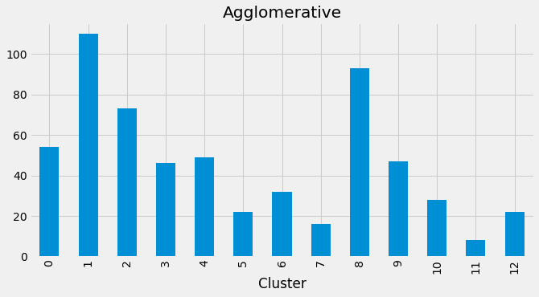
Agglomerative Clustering
It is a type of Hierarchical Clustering, which works using a bottom up approach by merging examples until the desired number of clusters is achieved.
The algorithm starts by treating each object as a singleton cluster. Next, pairs of clusters are successively merged until all clusters have been merged into one big cluster containing all objects. The result is a tree-based representation of the objects, named dendrogram.

Slide 23
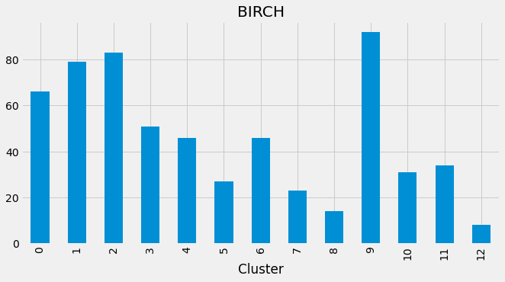
BIRCH Clustering
BIRCH - Balanced Iterative Reducing and Clustering using Hierarchies
It incrementally and dynamically clusters the incoming multi-dimensional metric data points to try to produce the best quality clustering
It summarizes large datasets into smaller, dense regions called Clustering Feature (CF) entries, and a CF tree is then generated

Slide 24
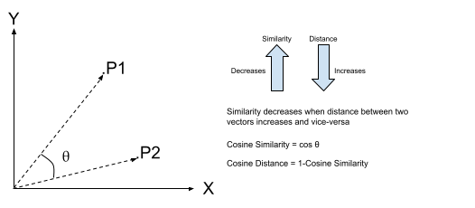
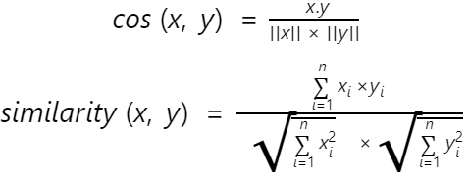
Cosine Similarity
Similarity measure refers to distance with dimensions representing features of the data object, in a dataset.
Cosine similarity is the cosine of the angle between two n-dimensional vectors in an n-dimensional space. It is the dot product of the two vectors divided by the product of the two vectors' lengths (or magnitudes).

Slide 25
Recommendation System
For recommending the next best job profile, and also an appropriate career path, we have used cosine similarity function and also a predictive function which works on a particular cluster and chooses the next best available profile.
First, we sort the cosine similarities obtained in the previous step.
The recommendation function takes into account the similarities of the profile and sorts it according to the average salary for each profile.
As a result, we obtain a new profile with a similar skill set and also a higher salary. By including both factors into consideration, we achieve a better recommendation compared to solely using the similarity function.
To build a career path as a recommendation to the user, we suggest three job profiles using the above function. The user can use this as a baseline to build his career, and learn the applicable skills that are required for each profile.

Slide 26
Salary Forecasting
Aim is to forecast the salary that one can expect after having about five to nine years of experience.
We forecast the average salary for each recommended profile after a period of five to nine years of experience, based on the current average salary
We are transforming the data using binary encoder to apply NLP techniques in the following steps

Slide 27


NLP applied to skills
First step when processing textual data is the removal of stop words such as ‘the’, ‘as’, etc.
The next strategy is to score the relative importance of words using TF-IDF.
TF stands for Term Frequency. It is the number of times a particular word appears in the overall document, divided by the total number of words in the document.
IDF stands for Inverse Data Frequency. The IDF is used to assign a weight to the remaining rare words present in all the documents within the corpus.
Final TF-IDF value is the product of TF and IDF values.

Slide 28
Regression
Linear Regression is a machine learning algorithm based on supervised learning.
Regression models a target prediction value based on independent variables. It is mostly used for finding out the relationship between variables and forecasting.
We have used NLP techniques described in the previous section over the skillset with average salary as the target variable, We performed a total of ten types of regression on our data: Linear, Lasso, Ridge, RidgeCV, SVR, LassoLarsCV, LassoLars, Bayesian Ridge, Tweedie Regressor and Polynomial Regressor.
We have used the R² value and the regression score(reg_score) as metrics to judge the accuracy of the models.

Slide 29
Linear Regression and Lasso Regression
Linear Regression fits a linear model with coefficients w = (w1, …, wp) to minimize the residual sum of squares between the observed targets in the dataset, and the targets predicted by the linear approximation. Here, we are using Ordinary least squares Linear Regression.
Reg_score = 0.7921219732980164, R² score = 0.5985742547476479
Lasso stands for least absolute shrinkage and selection operator. It not only helps in reducing overfitting but it can help us in feature selection, as it uses L1 regularization (adds penalty equivalent to absolute value of the magnitude of coefficients).
Reg_score = 0.7921379027390649, R² score = 0.5990990164719194
Based on these two metrics, we have proceeded with Lasso regression.

Slide 30
Results

Slide 31
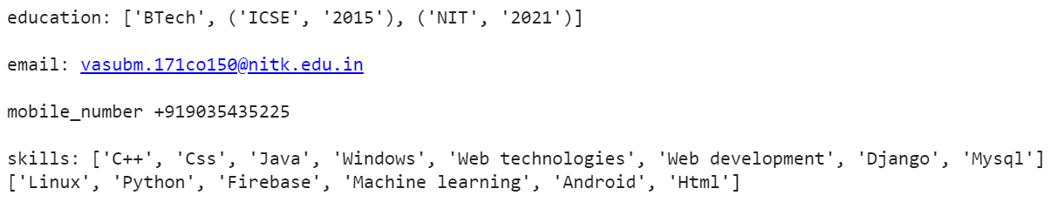
Resume Parser
This is the final result obtained after parsing a sample resume. We extract the data pertaining to education, contact details such as email and mobile number, and the set of skills possessed by the user.

Slide 32
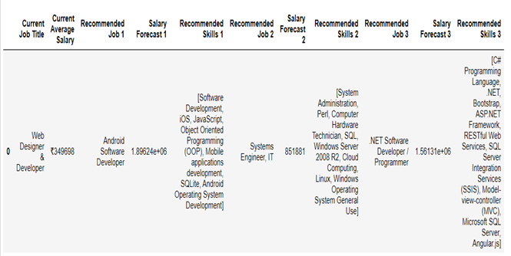
Recommender
Once we parse the data, we find the appropriate current job title based on the skills given in the resume. We use this as a base to recommend three profiles in increasing order of average salary that the user can look to consider as his/her future career path. We also provide a list of additional skills required to reach the recommended profiles.

Slide 33
Salary Forecast
Salary Forecast is done after performing NLP on the skills and then using tweedie regressor on the current average salary to forecast what salary that the user can expect if he/she chooses the recommended profiles after a span of five to nine years.

Slide 34
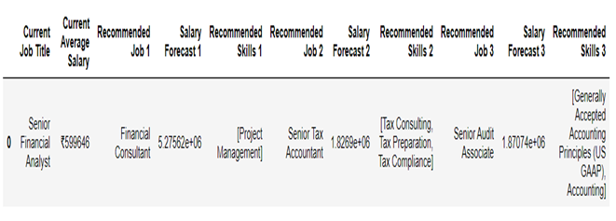
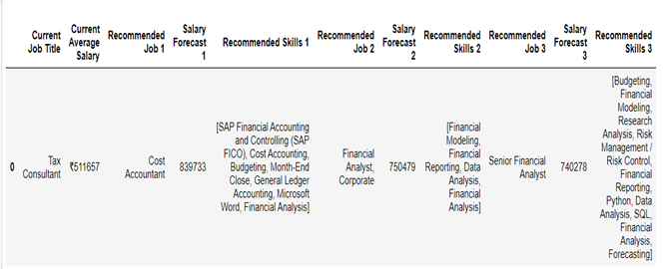
Salary Forecast

Slide 35
Results Comparison
To improve final performance in forecasting further, we’ve tried different models in our data set.
From the literature survey, the authors were able to achieve an R² value of 0.462 when using Random Forest and Gradient Boost Trees.
From another reference, the results have yielded an adjusted R² value in the range of 0.1493 to 0.1496 for the three models they proposed. One fact to note here is that, while in this reference, the authors have used Adjusted R² as the metric, Adjusted R² value will always be less than or equal to R² value.
Meanwhile our results are far more promising, with an R² value of 0.5990 when using the Lasso regression model and 0.5985 for Linear Regression model.

Slide 36
Conclusion and Future Work

Slide 37
The resumes will be written in many file formats and may differ in their fonts or structure. Hence resume parsing is an intricate task in automatic job recruitment tools. The proposed system extracts the required data from the resumes by matching the regular expressions and using NLP techniques
Next, the system exploits an integrated skills knowledge base for carrying out the recommendation task. This consists of four stages namely Data mining, Data filtering, BIRCH Clustering and Recommendation system. Combination of these four stages recommends an appropriate career path.
Salary Forecasting that one can expect after having about five to nine years of experience.
Future work suggested was to take up an enlarged dataset and improve the performance of the proposed system. Can try to integrate parser and recommender more precisely, i.e. by extracting the skills and directly passing it to the recommender. To do so, we will need an appropriate dataset of skills matched to skills mentioned in the resume. Another idea can be to include a job description, and rank the resumes in the order in which it best fits the job description.

Slide 38
Thank You

